Slide 1
Project: E-Marching
CSCE 4901 - Team: Nova Elite
Jason Hoang
KaiChuan Chan
Sabrin Thamed
Imran Ahktar

Slide 2
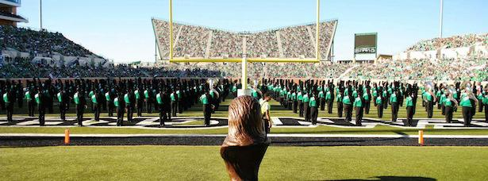
Introduction
The Marching Band
Teacher App and Student App
Less Paperwork and easier organization
Provide a direct form of communication between the teacher and the student

Slide 3
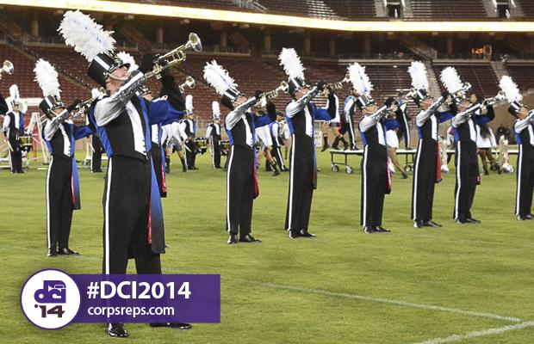
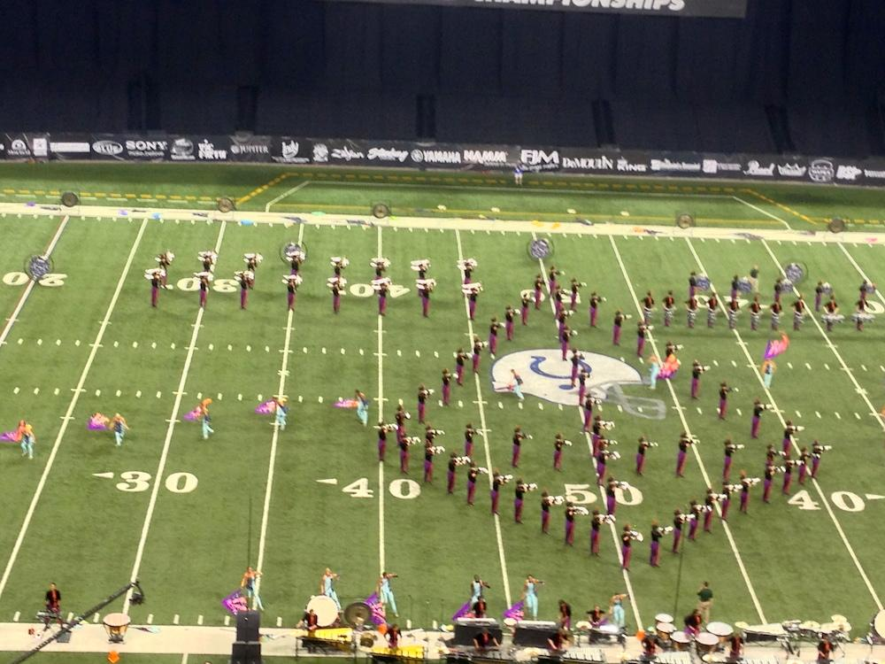
The Client
Texas High School Band Director
Performed in 2 World Class Drum Corps - won the world championship with both groups
Participated on staff with multiple State Level high school marching bands
Graduate from the University of North Texas
Just gave us some ideas and guidelines to work towards
Not a lot of time to share with us being a teacher during the UiL season

Slide 4


Altered Scope
MusicXML
Marching Band software (e.g. Pyware)
Android Studios
Not all uses of paper is cut from the program

Slide 5

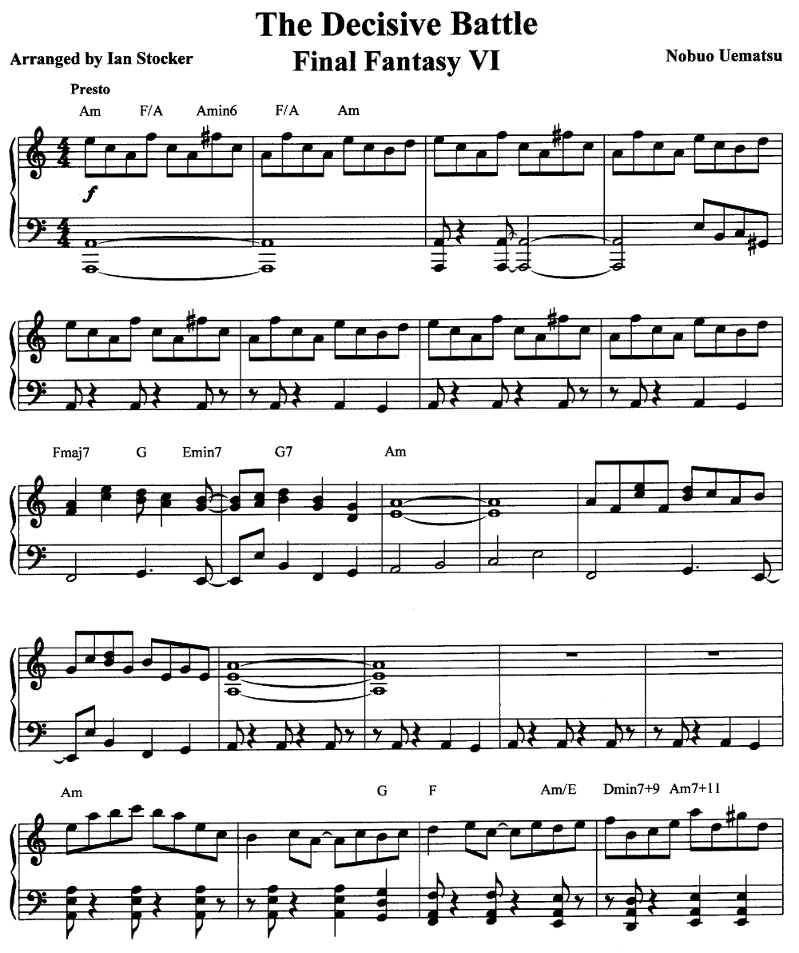
The Functional Requirements
Online Database
Login/Logout Authentication
Music Presentation and Editing
Coordinates Presentation and Editing
Notifications - communication between the apps
Menu Bar - Navigation and tools
Attendance

Slide 6
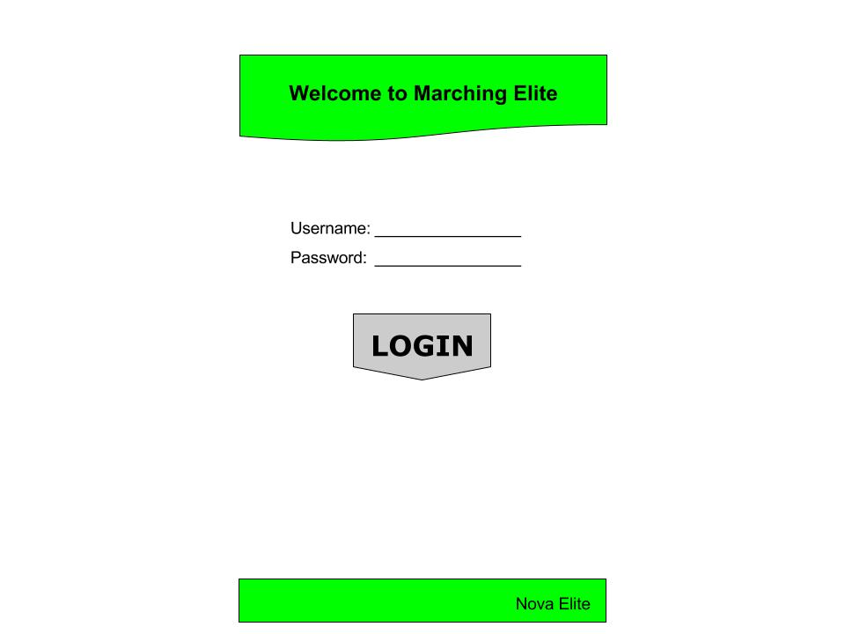
Non-functional requirements
No major visual requirements requested by the client
Other than the format of the coordinate sheets
Must be easy to use - for educational purposes
Speed and Latency requirements
Database Capacity
Easy to access for students

Slide 7
Project Organization
Three Phases:
Building the Database
Developing the Base Application
Configuring the Communication Functionalities

Slide 8
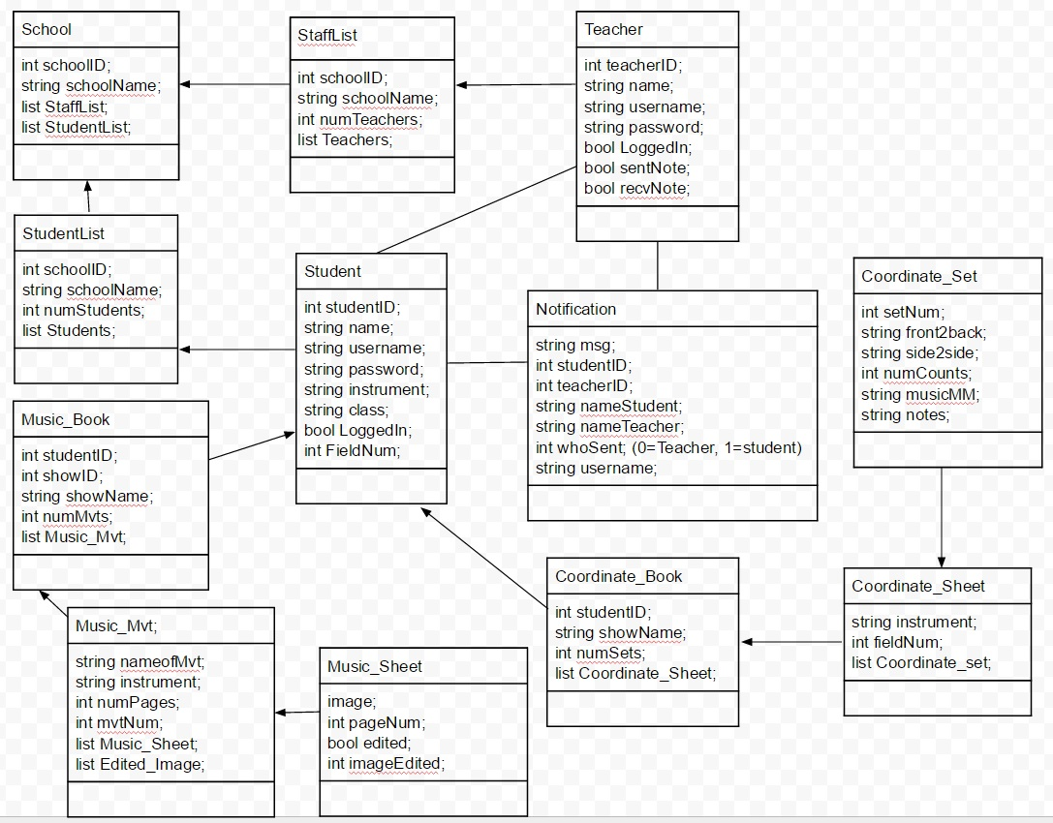
Class Diagram

Slide 9

Hardware and Software
Java JDK5 or later version
Android devices
Android Studio 1.5
Android Development Tools (ADT)
Android SDK
Java Runtime Environment (JRE) 6

Slide 10

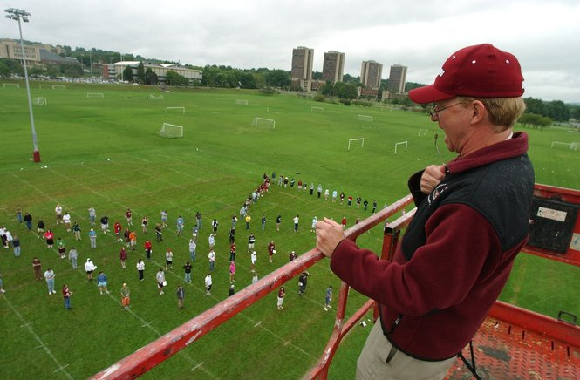
Project Constraints
Time
Team scheduling
Limited real world testing scenarios
Equipment and scale
Knowledge available to research for development
Feature constraints
Difficulty implementing musicXML and Pyware compatibility

Slide 11
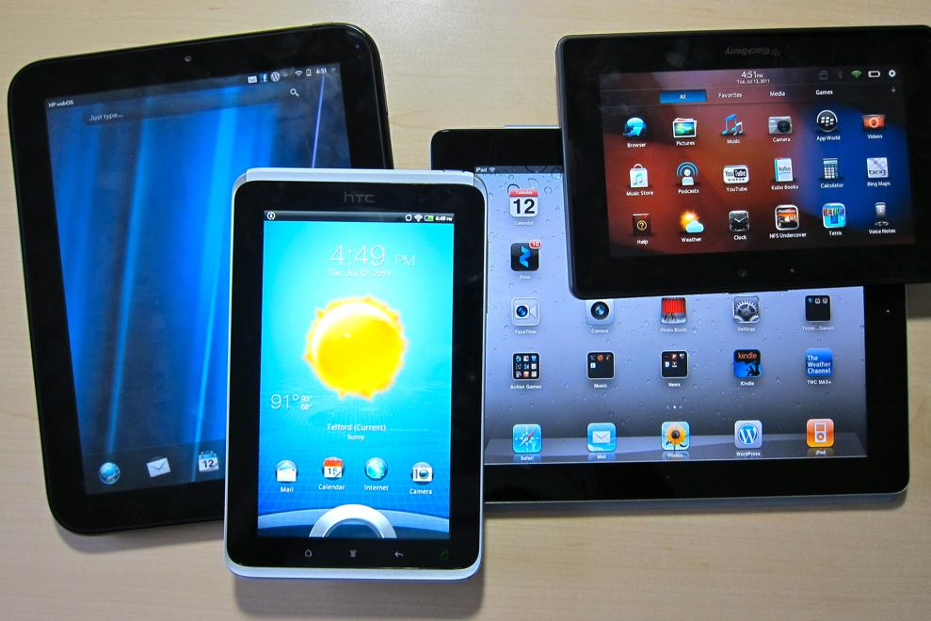
Project issues
Device compatibility
School funded Androids or iPads
Working Environment
Android Studios can be difficult to use, especially with different CPUs

Slide 12

Challenges in Design
Accommodating for what Android Studios has to offer
Communicating between two apps efficiently and effectively
Finding other ways to replace or implement features that Android doesn’t offer directly.

Slide 13
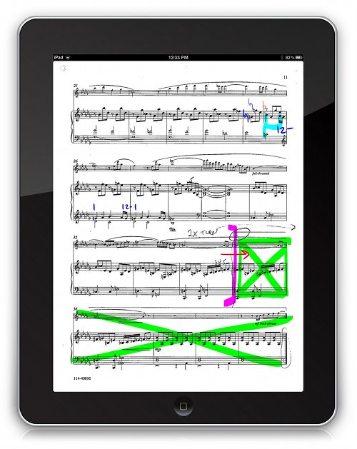
Challenges moving forward
Implementing the editing functionalities for the music and coordinates.
Connecting the communication systems between apps.
Optimizing the applications for easy and efficient use by the client.

Slide 14

Lessons Learned
Planning ahead saves a ton of time and work down the road.
Clear and direct communication between team members keeps the project moving forward.
The internet is our best friend.

Slide 15
Finishing on time
Time
Difficulty of the unknown issues from development
Teamwork
Potential changes needed by design/client

